Slide 1
Natural Language Processing
- Formal Language -
(formal) Language
(formal) Grammar

Slide 2
Formal Language
A formal language L is a set of finite-length words (or "strings") over some finite alphabet A. ε is the empty word.
Example:
A = {a, b, c}
L₁ = {ab, c}

Slide 3
Formal Languages - Examples
Some examples of formal languages:
the set of all words over {a, b},
the set { a^{n} | n is a prime number },
the set of syntactically correct programs in some programming language, or
the set of inputs upon which a certain Turing machine halts.

Slide 4
Several operations can be used to produce new languages from given ones. Suppose L1 and L2 are languages over some common alphabet.
The concatenation L1L2 consists of all strings of the form vw where v is a string from L1 and w is a string from L2.
The intersection of L1 and L2 consists of all strings which are contained in L1 and also in L2.
The union of L1 and L2 consists of all strings which are contained in L1 or in L2.
The complement of the language L1 consists of all strings over the alphabet which are not contained in L1.
The Kleene star L1* consists of all strings which can be written in the form w1w2...wn with strings wi in L1 and n ≥ 0. Note that this includes the empty string ε because n = 0 is allowed.

Slide 5
A formal language can be specified in a great variety of ways, such as:
Strings produced by some formal grammar (see Chomsky hierarchy)
Strings produced by a regular expression
Strings accepted by some automaton, such as a Turing machine or finite state automaton
From a set of related YES/NO questions those ones for which the answer is YES, see decision problem

Slide 6
Formal Grammar - Definition
A formal grammar G = (N, Σ, P, S) consists of:
A finite set N of nonterminal symbols.
A finite set Σ of terminal symbols that is disjoint from N.
A finite set P of production rules where a rule is of the form
    string in (Σ U N)* -> string in (Σ U N)*
  (where * is the Kleene star and U is set union)
  the left-hand side of a rule must contain at least one nonterminal symbol.
A symbol S in N that is indicated as the start symbol.

Slide 7
Language of a Formal Grammar
The language of a formal grammar G = (N, Σ, P, S), denoted as L(G), is defined as all those strings over Σ that can be generated by starting with the start symbol S and then applying the production rules in P until no more nonterminal symbols are present.

Slide 8
Language of a Formal Grammar
Example
Consider, for example, the grammar G with N = {S, B}, Σ = {a, b, c}, P consisting of the following production rules
  1. S -> aBSc
  2. S -> abc
  3. Ba -> aB
  4. Bb -> bb
This grammar defines the language {a^{n}b^{n}c^{n} | n>0}

Slide 9
Chomsky's four types of grammars
Type-0 grammars (unrestricted grammars)
languages recognized by a Turing machine
Type-1 grammars (context-sensitive grammars)
Turing machine with bounded tape
Type-2 grammars (context-free grammars)
non-deterministic pushdown automaton
Type-3 grammars (regular grammars)
regular expressions, finite state automaton

Slide 10
Grammars, Languages, Machines
Type-0
Recursively enumerable Turing machine No restrictions
Type-1
Context-sensitive Linear-bounded αAβ -> αγβ
non-deterministic
Turing machine
Type-2
Context-free Non-deterministic A -> γ
pushdown automaton
Type-3
Regular Finite state automaton A -> aB
A -> a

Slide 11
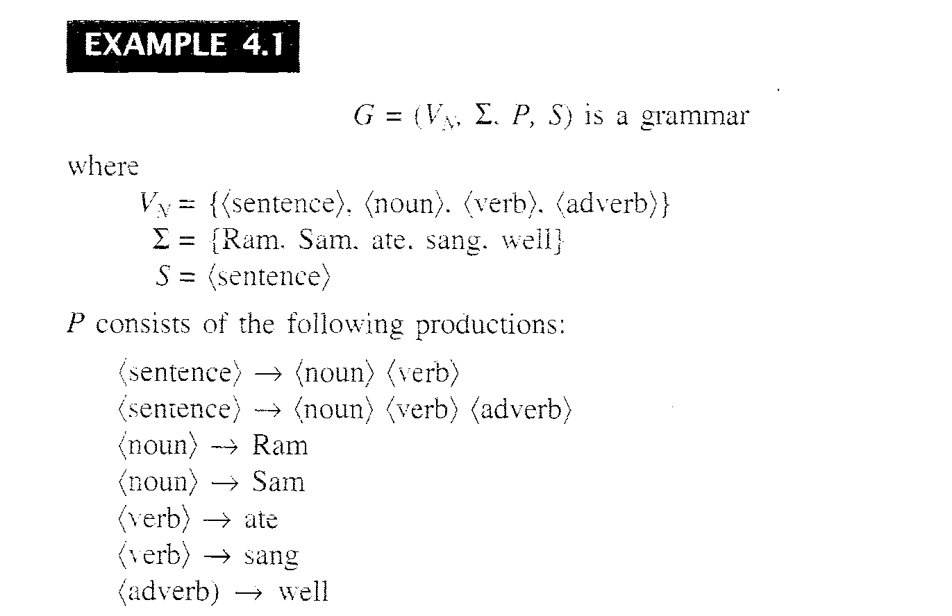
Example

